Slide 1
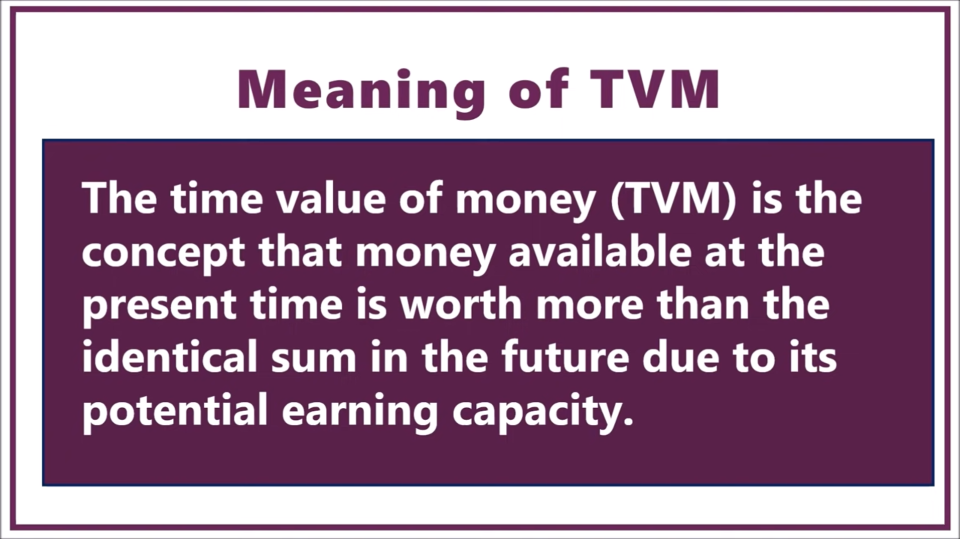

Slide 2
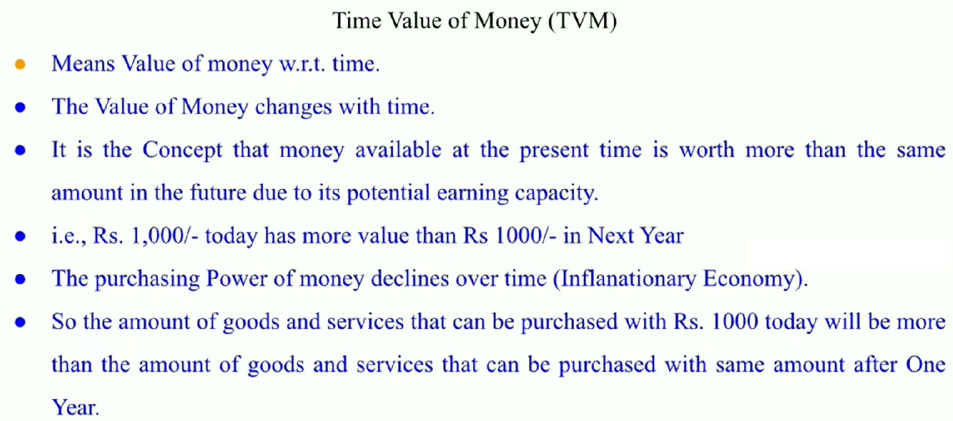

Slide 3
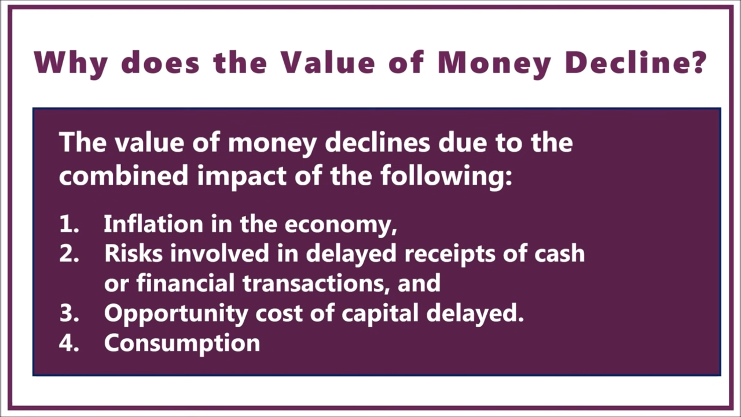

Slide 4
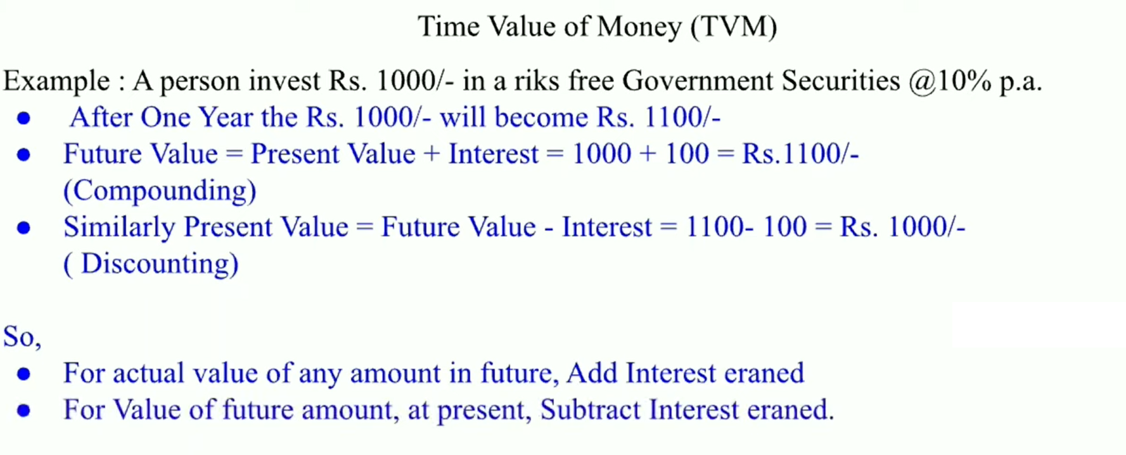

Slide 5
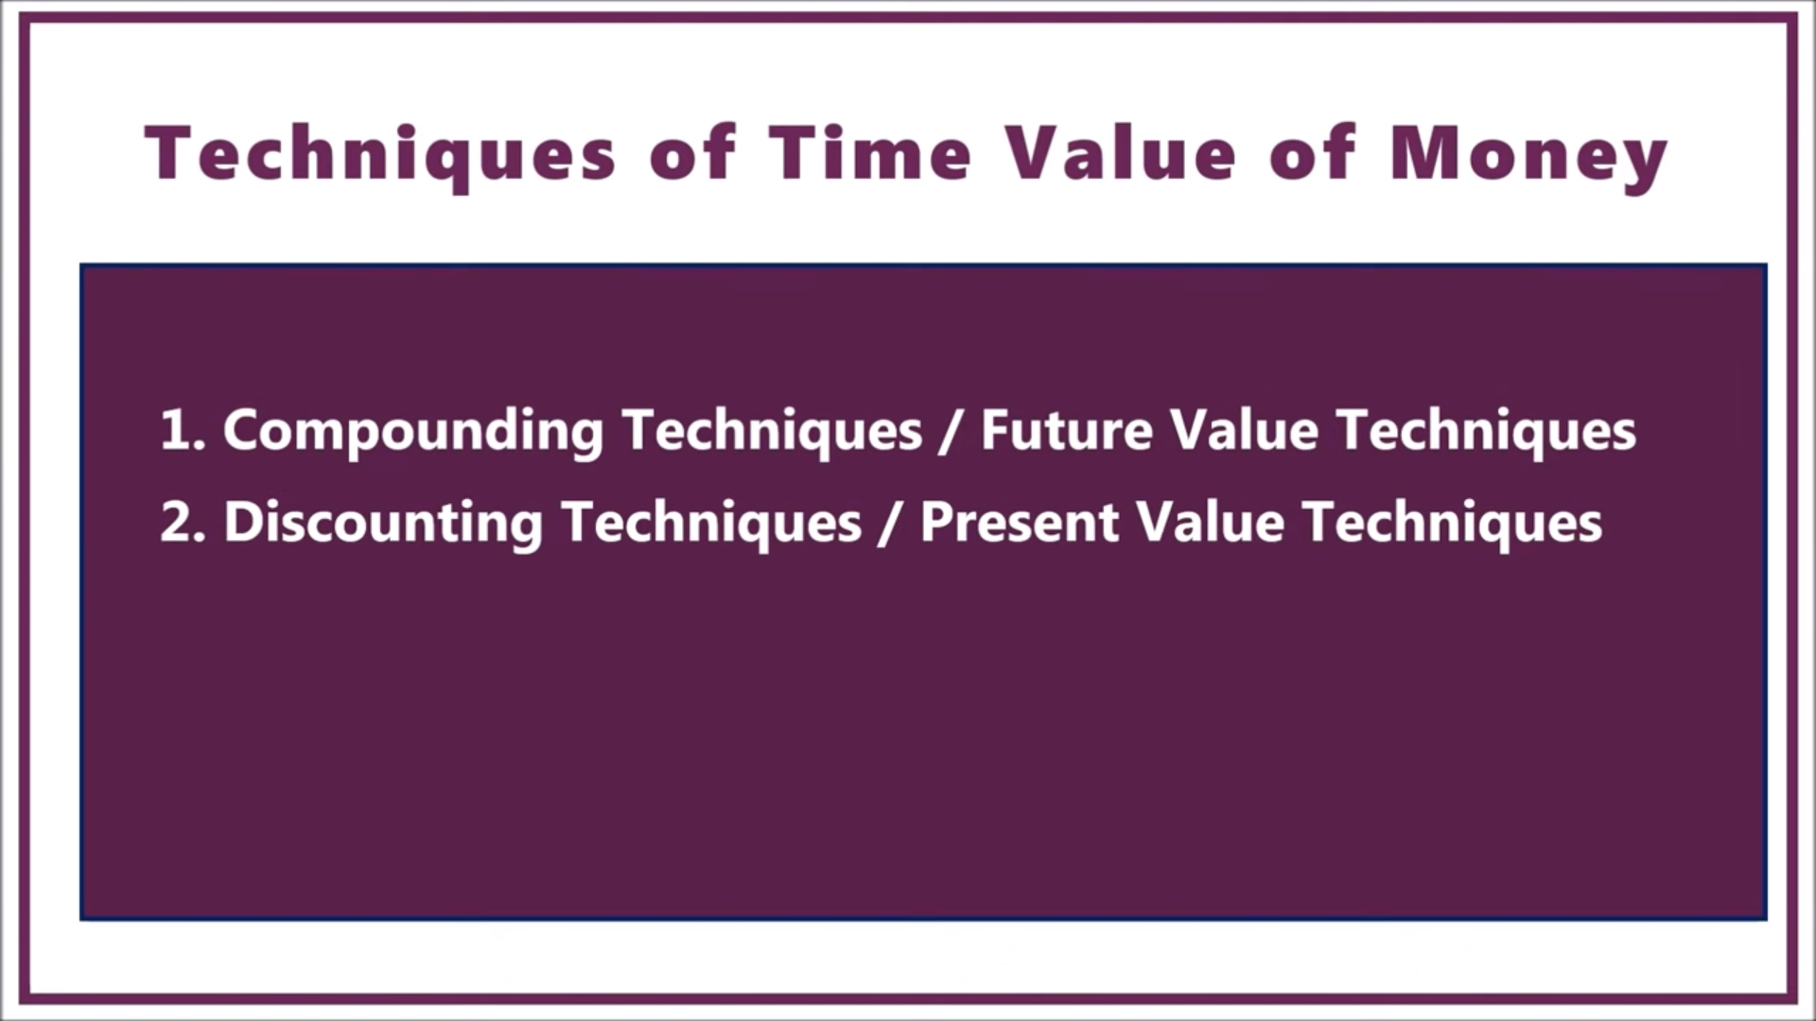

Slide 6
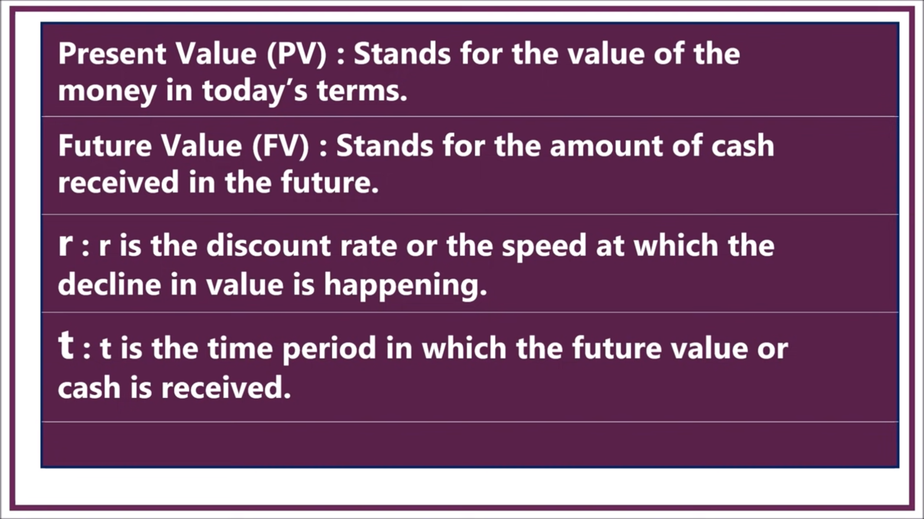

Slide 7
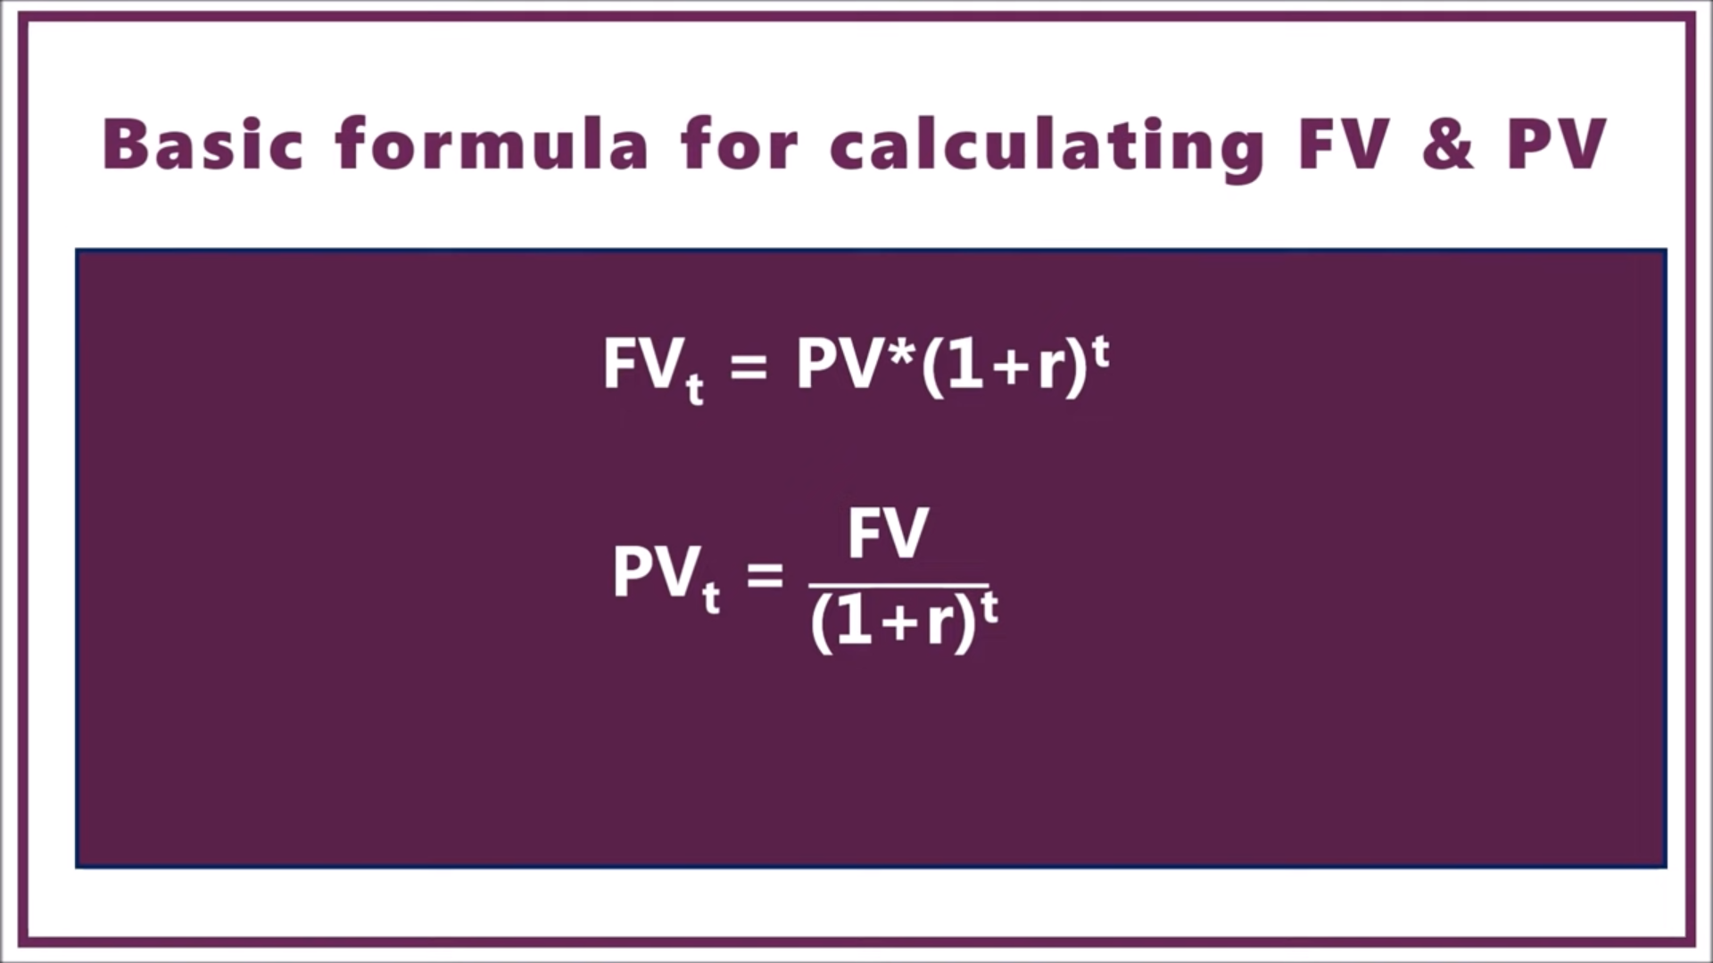

Slide 8
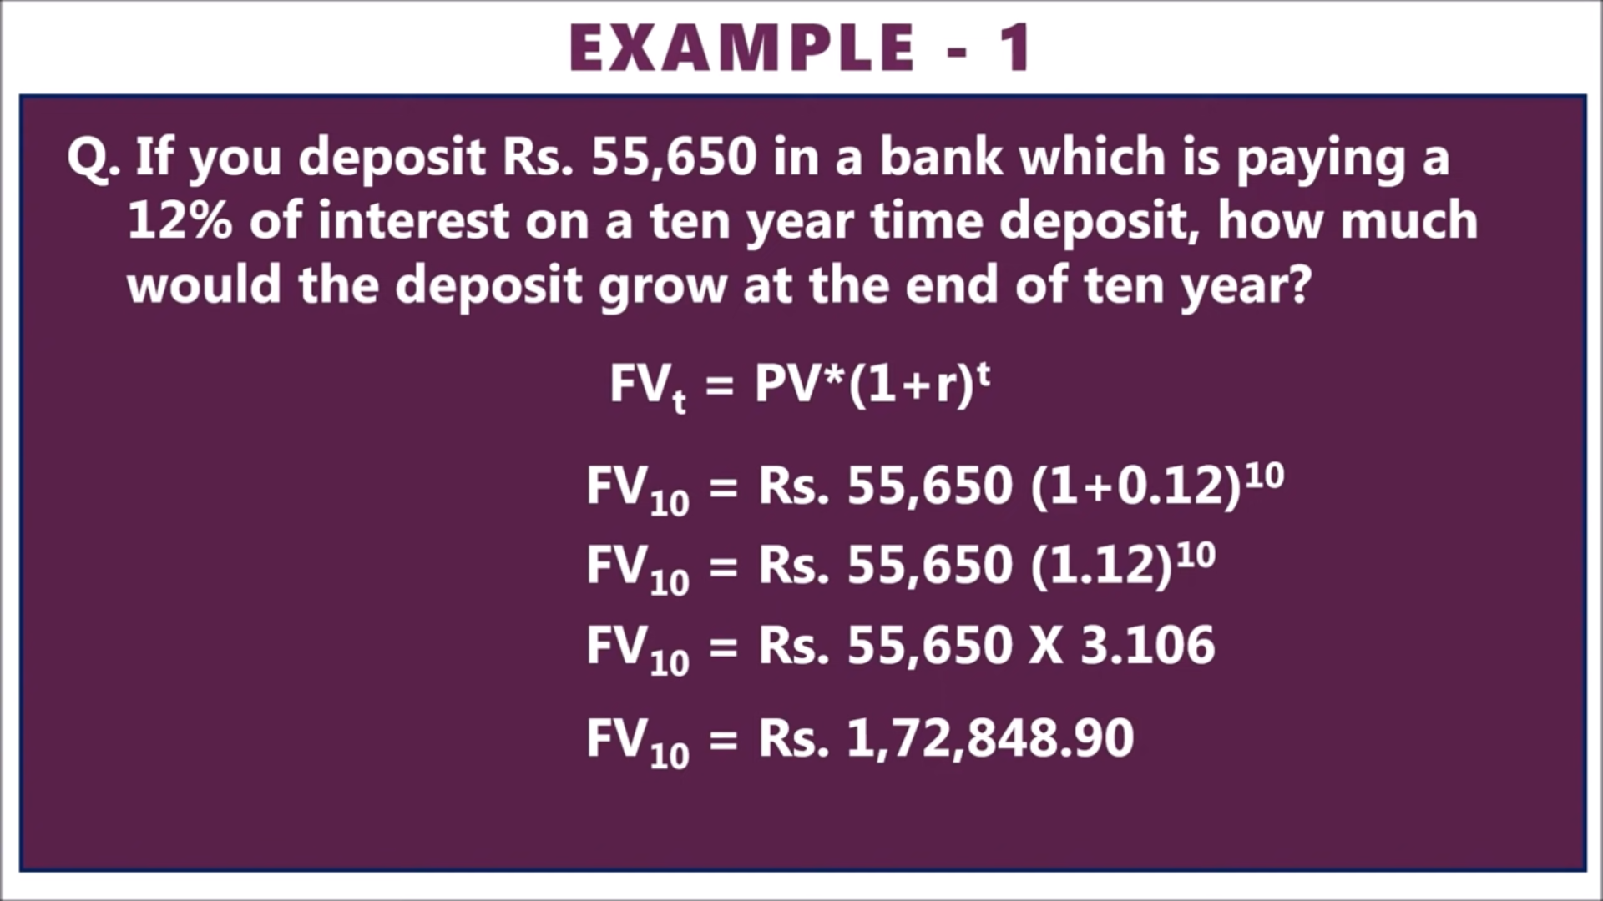

Slide 9
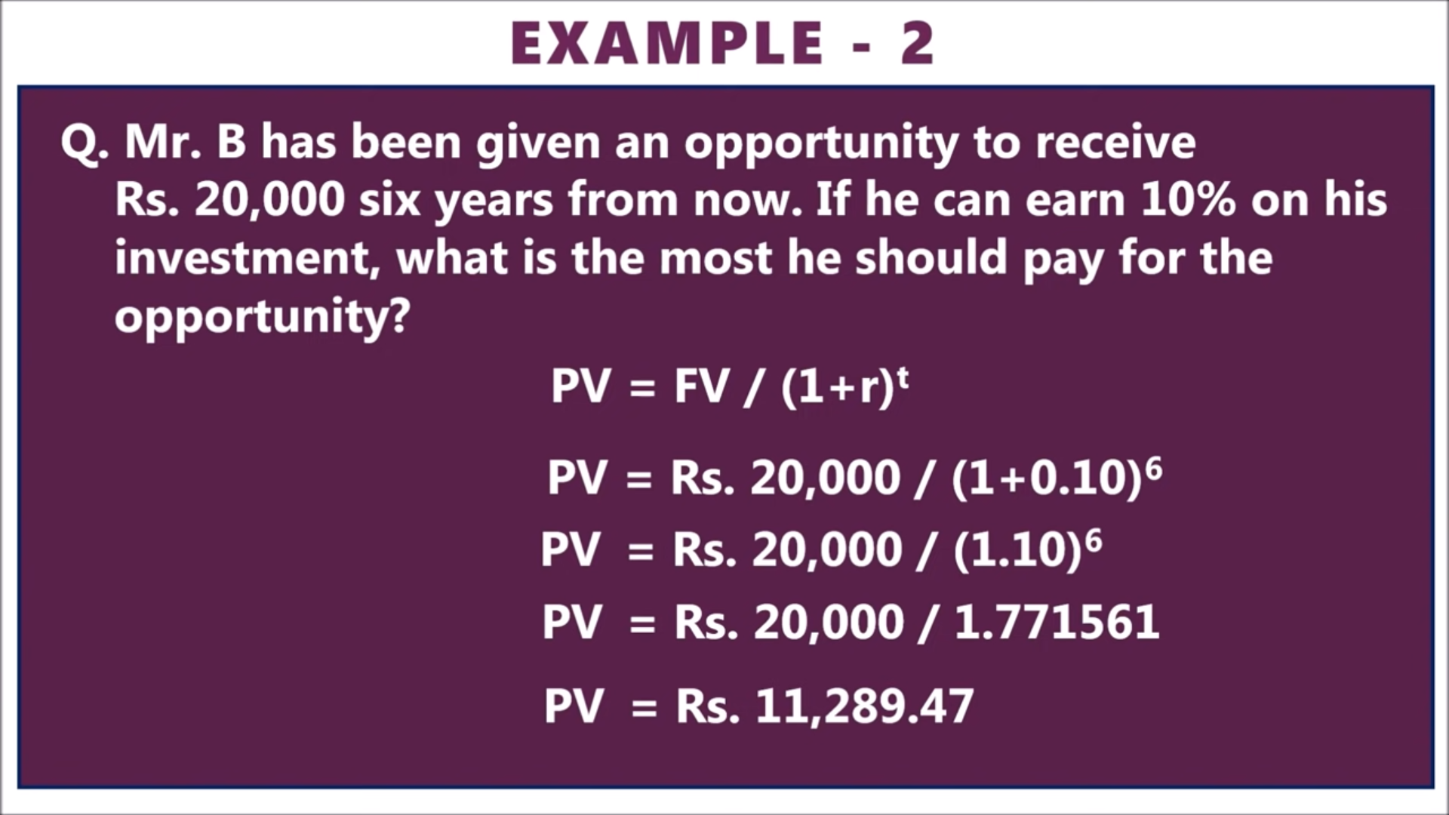

Slide 10
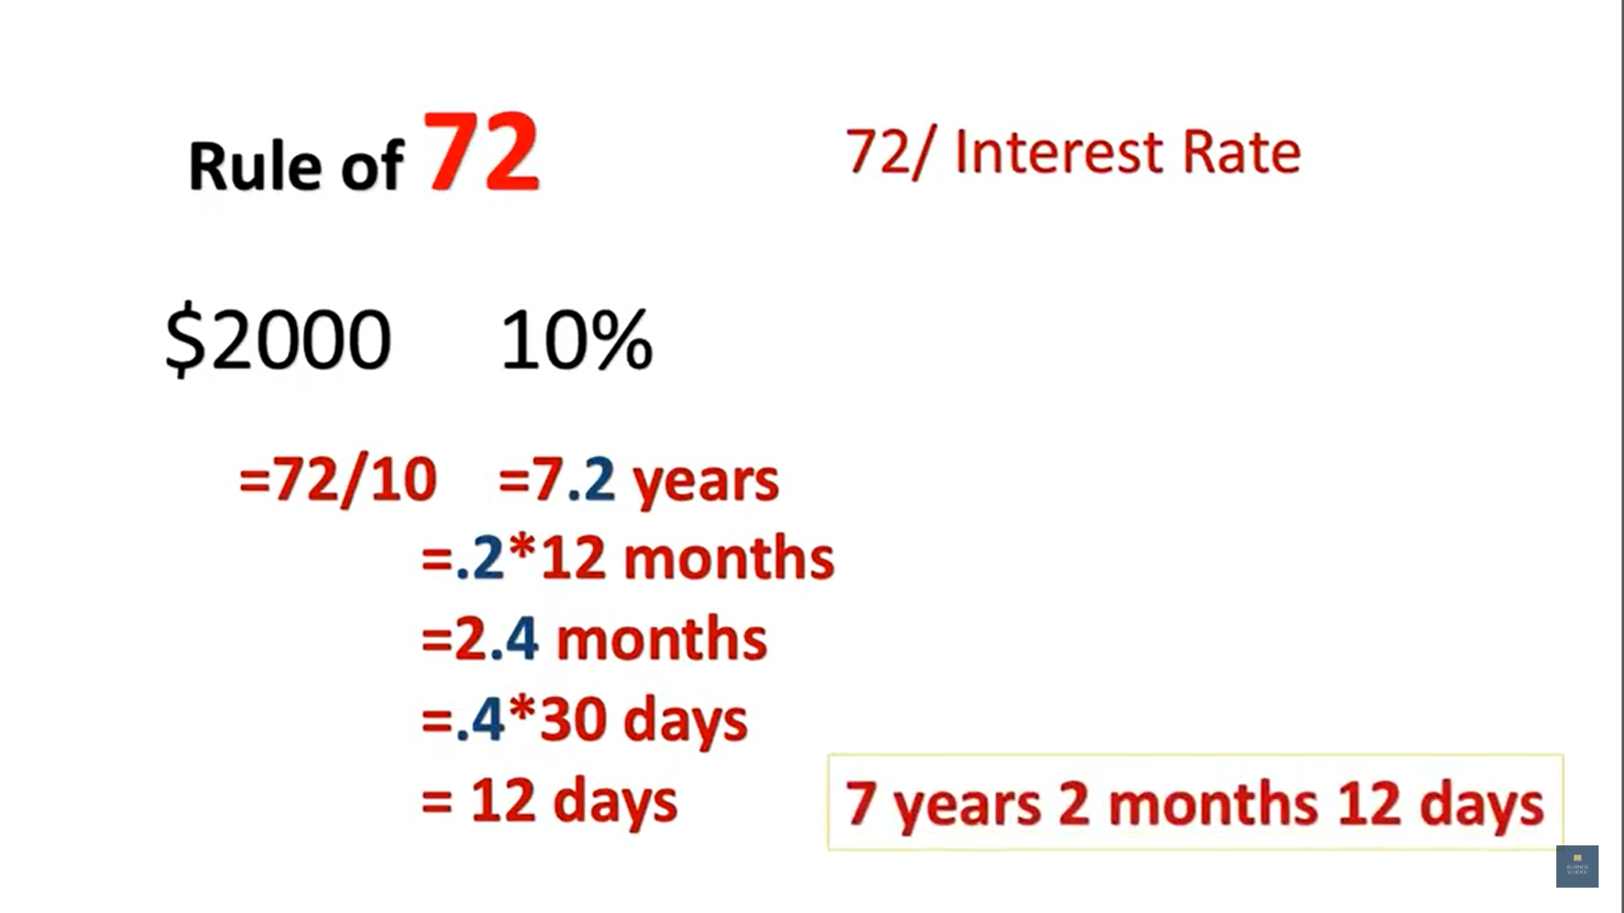

Slide 11
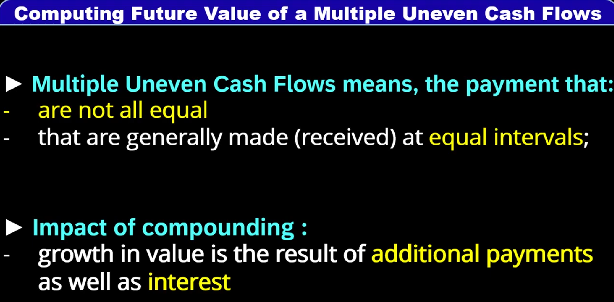

Slide 12
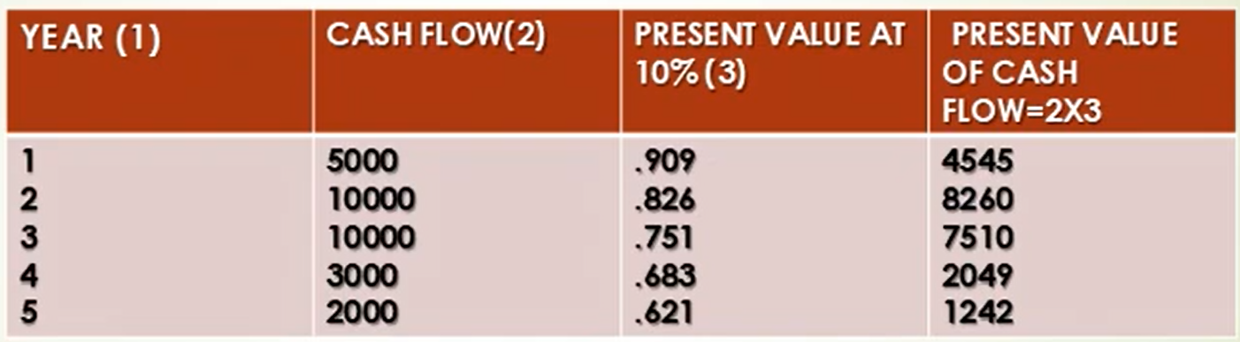

Slide 13
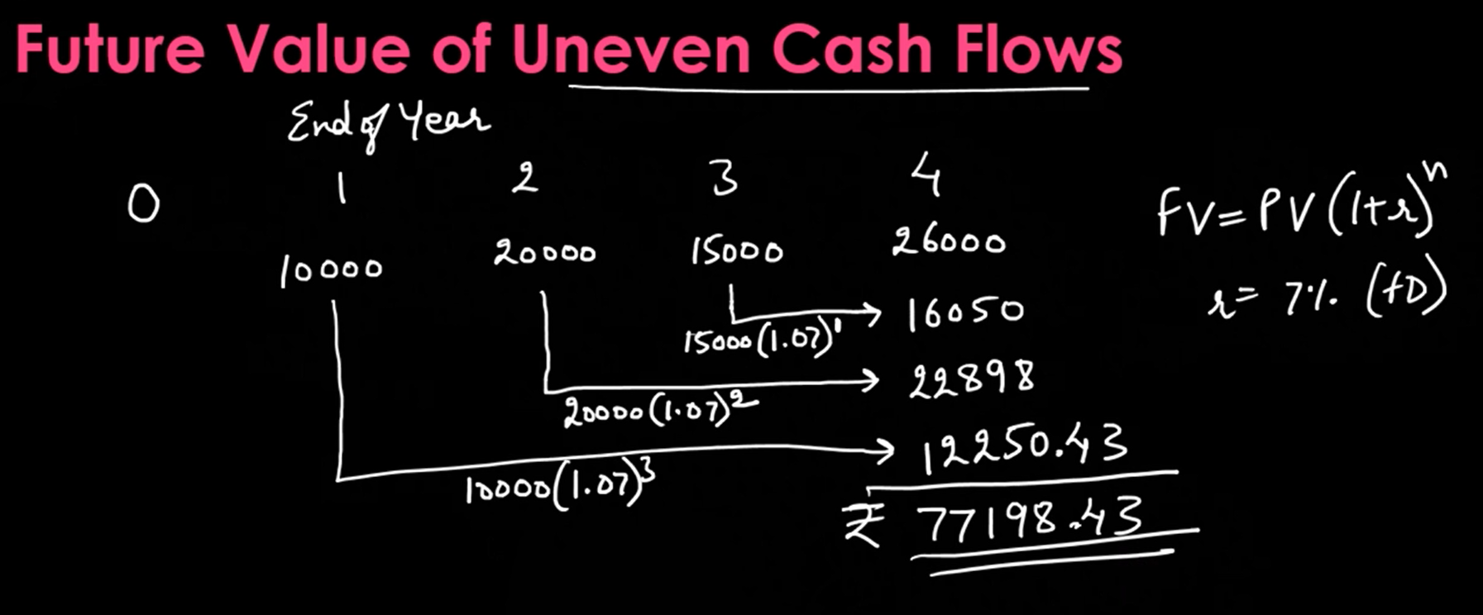

Slide 14
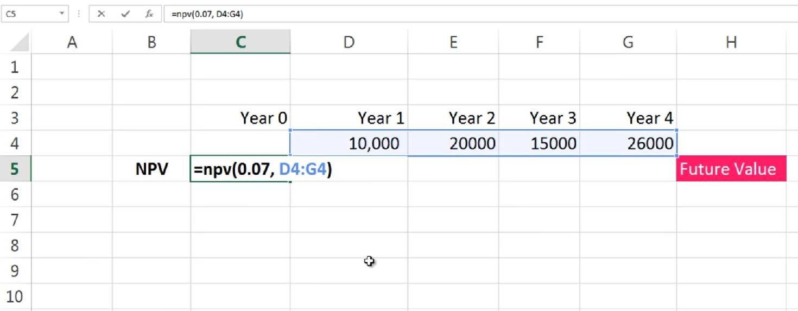

Slide 15
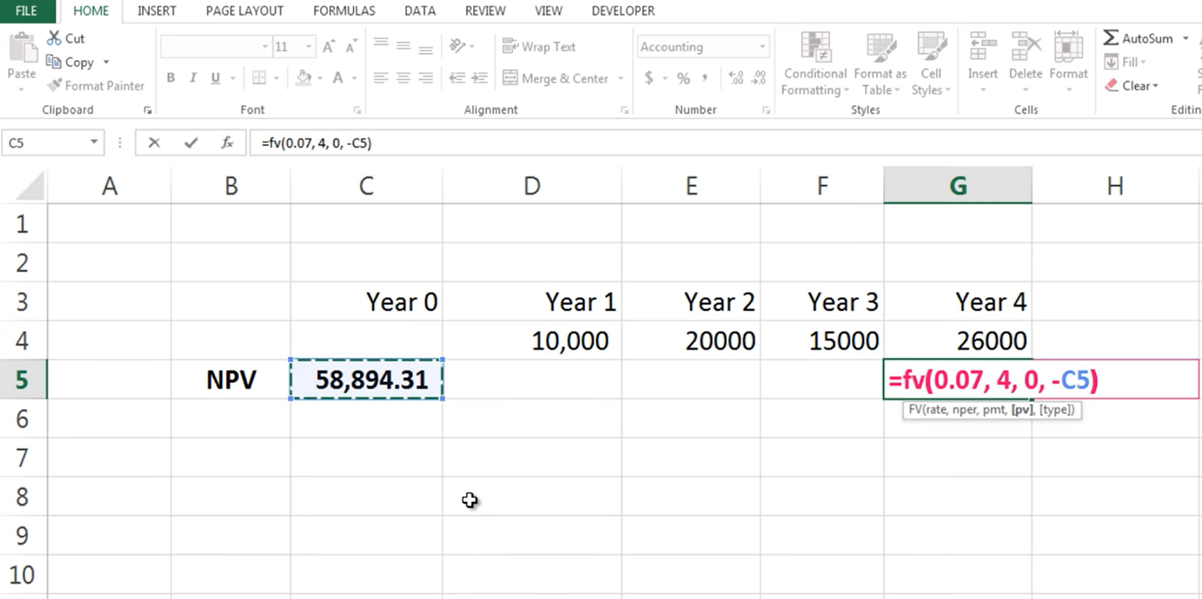

Slide 16
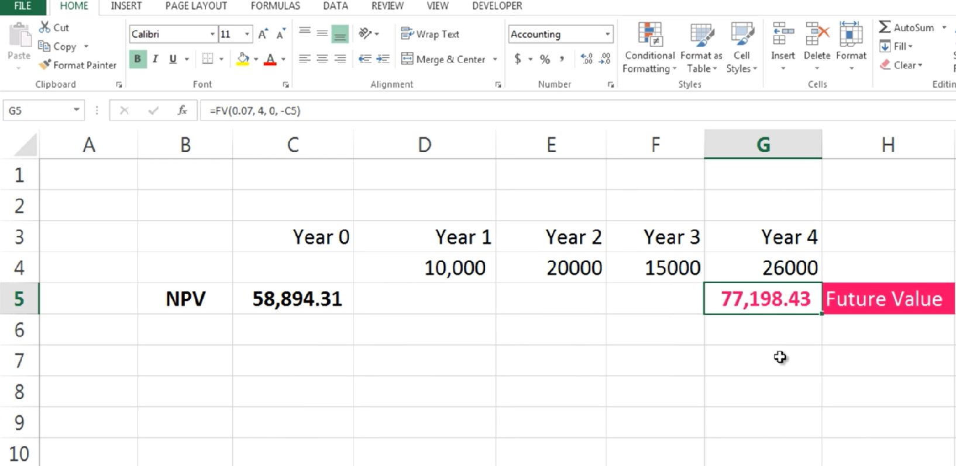

Slide 17
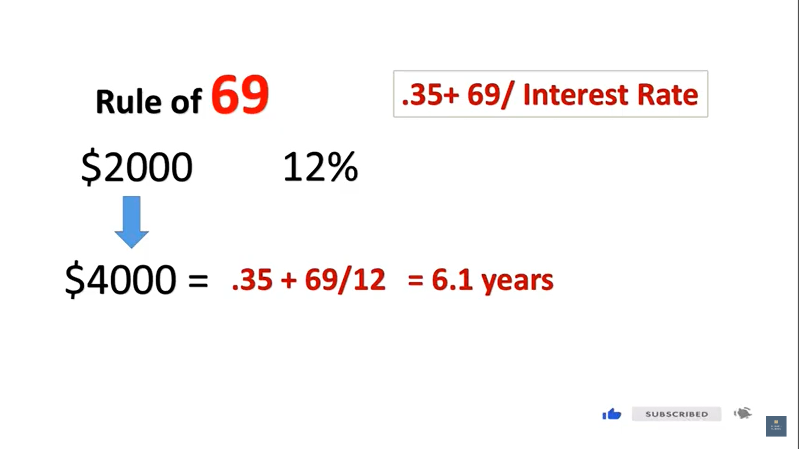

Slide 18
Annuity
Annuity represents to the payment/receipt after equal interval. A payment can be called as annuity provided:
Time Gap between two installments is same.
Amount in each installment is same.

Slide 19
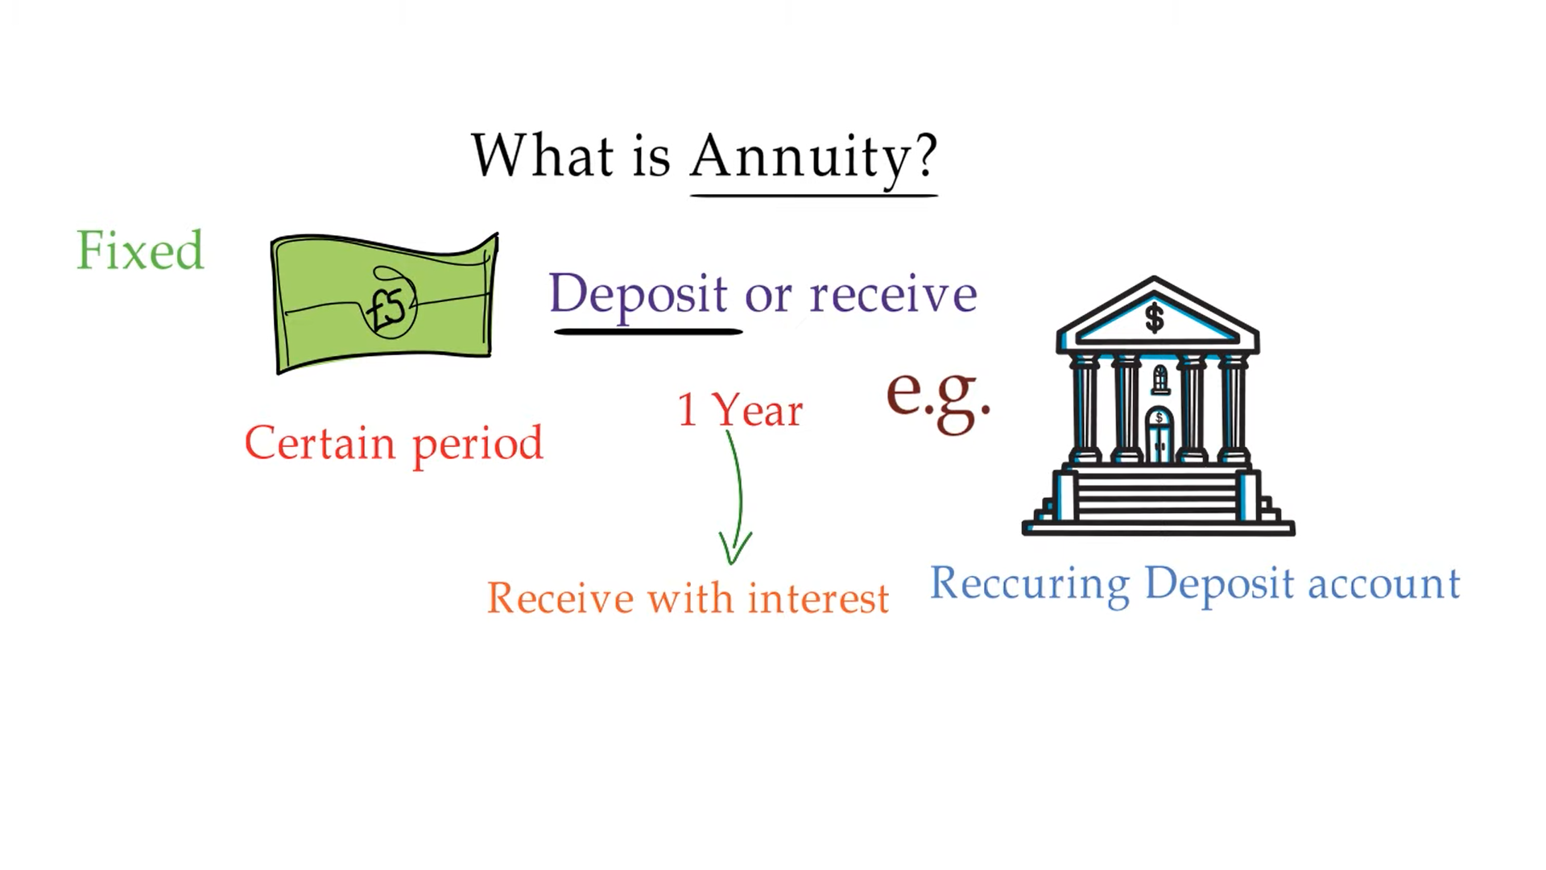

Slide 20
What is an Annuity?
Annuity is a fixed payment or receipt each year for a specified number of years.
If you rent a flat and promise to make a series of payments over an agreed period, you have created an annuity. The equal-instalment loans from the house financing companies or employers are common examples of annuities.

Slide 21
Types of Annuity
Ordinary Annuity: An ordinary annuity makes (or requires) payments at the end of each period. E.g. bonds interest payment
Annuity Due: With an annuity due, payments come at the beginning of each period. E.g. Rent charged by landlords

Slide 22
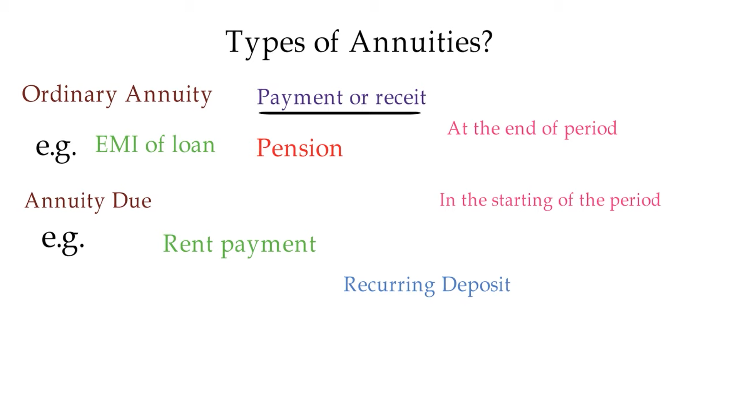

Slide 23
32
Future Value of Annuity (at the end of Year)
The future value of the ordinary annuity (FVA Ordinary) the receipts are assumed to be at the end of the period where rate of interest is compounded annually.
n
(1+r)
1
FVA =
A
*
r
n
(1+r)
1
Where
= Future Value Interest Factor (FVIFA)
r

Slide 24
33
Future Value of Annuity (at the end of Year, example)
Ms. Kusum will retire in 20 years. She wants a corpus of 2 crore at her retirement age. How much money she should deposit each year to accumulate the mentioned amount in 20 years assuming rate of interest 15% p.a.
20
(1+0.15)
1
A
2,00,00,000 =
*
0.15
1
15.37
16.37
A
2,00,00,000 =
*
0.15
0.15
2,00,00,000
A =
Rs. 1,95,179 p.a.
102.47

Slide 25
What is the future value of Rs. 20,000 invested now for a period of 5 years at an interest rate of 8% p.a. compounded quarterly?
5*4
5*4
0.08
20,000
1 +
0.08
FV =
4
4
= Rs. 29,718

Slide 26
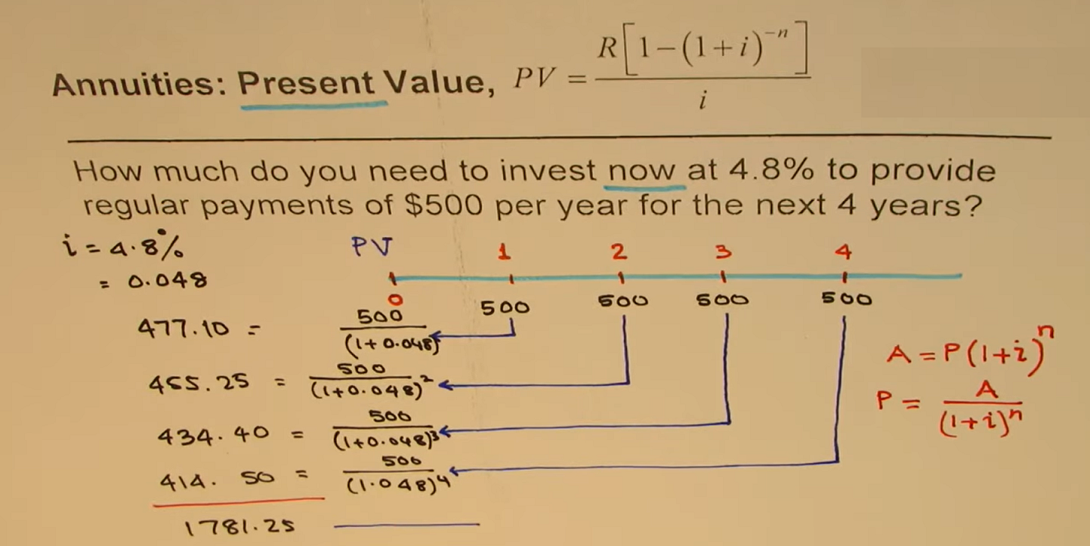

Slide 27
What Is Perpetuity?
The Present Value of Perpetuity represents to annuity ending till perpetuity/ forever or till one’s life, i.e., there is no defined ending period of the annuity.

Slide 28
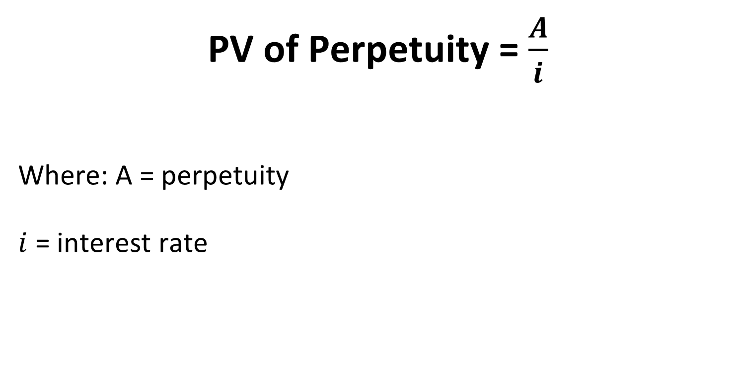
Present Value of Perpetuity

Slide 29
Illustration
An investor expects a perpetual sum of ₹ 500 annually from his investment. What is the present value of this perpetuity if interest rate is 10%?
₹ 5000
₹ 6000
₹ 6500
₹ 5500

Slide 30
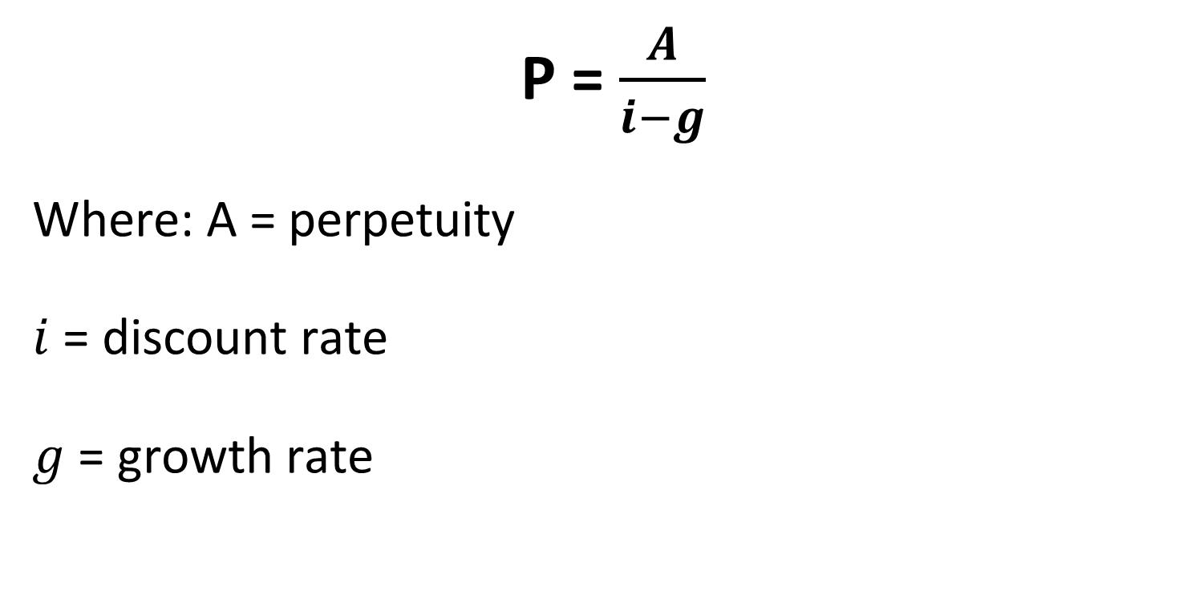
PV of Growing Perpetuity

Slide 31
Illustration
An annual cash flow of $1000 that will continue indefinitely. This cash flow is expected to grow at 5% per year and the required return used for the discount rate is 10%. What would be present value of a growing perpetuity?
$ 20000
$ 20500
$ 21000
$ 21500

